Slide 1
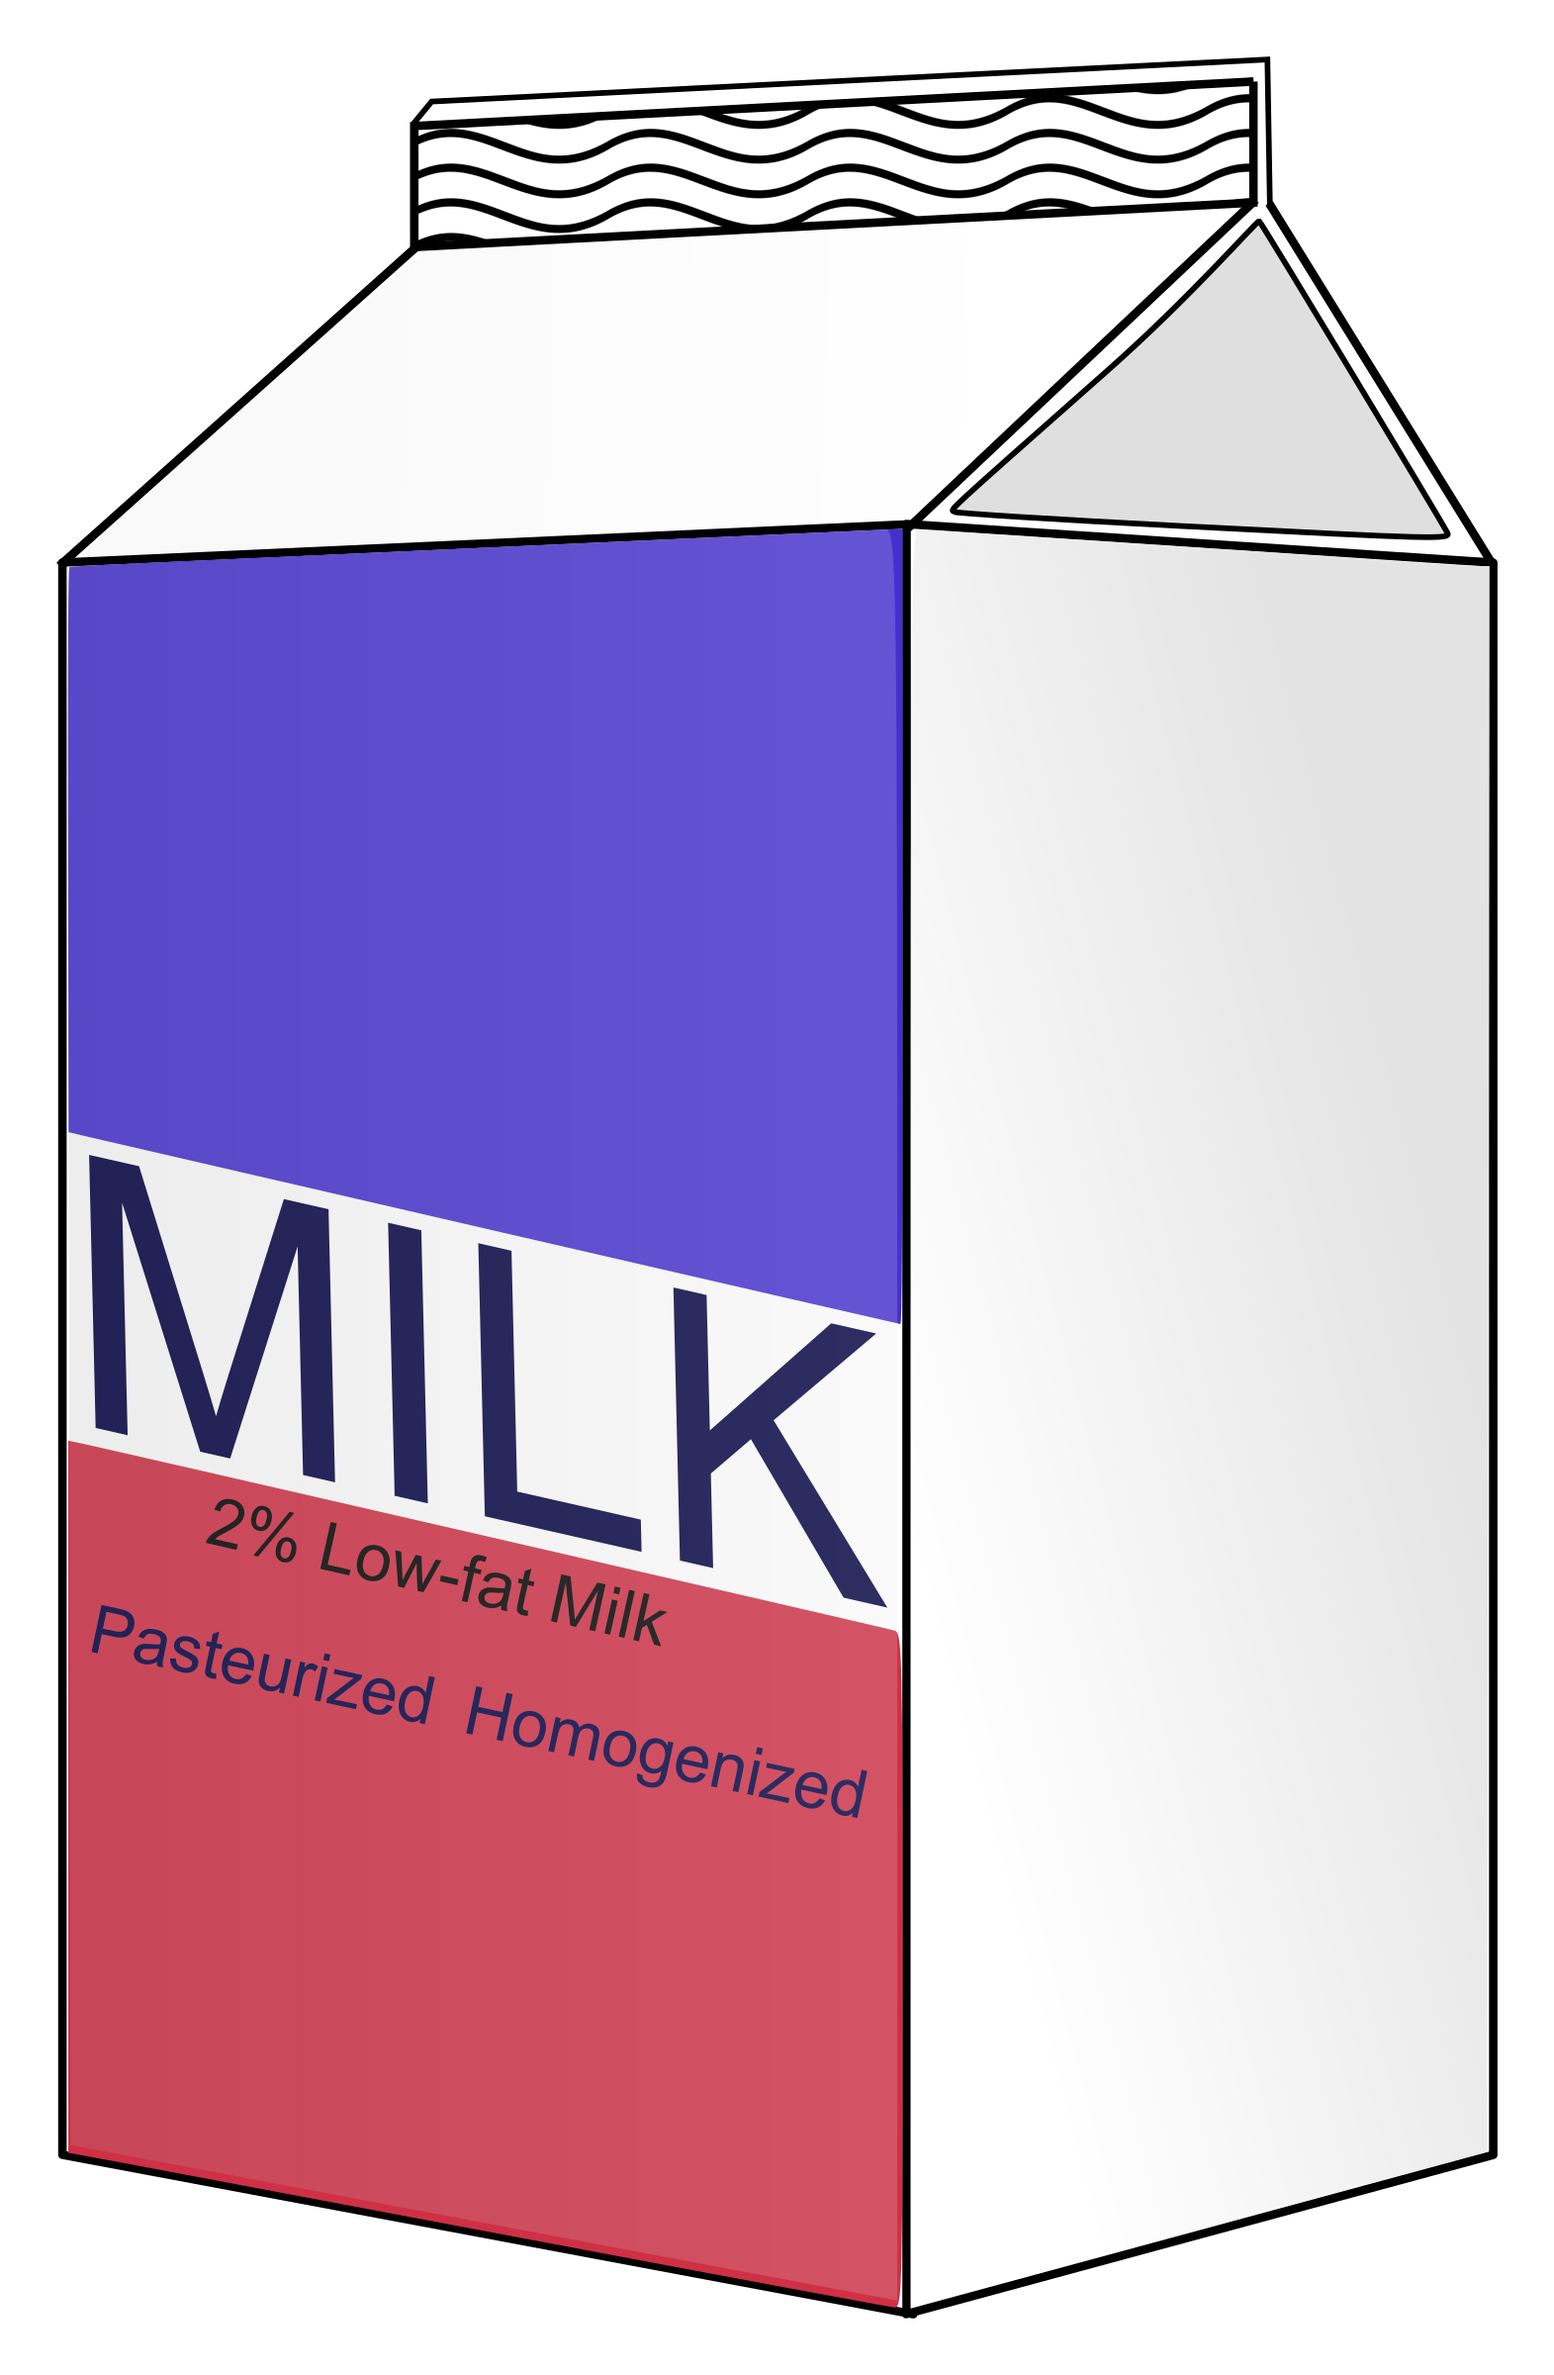

Milk

Slide 2

Bread

Slide 3

Butter

Slide 4

Egg

Slide 5

Fruit

Slide 6

Fruit Juice

Slide 7

Banana

Slide 8

Grapes

Slide 9


Orange

Slide 10

Apple

Slide 11

Mango

Slide 12

Watermelon

Slide 13

Pineapple

Slide 14

Pear

Slide 15

Sugar
sugar

Slide 16

Salt

Slide 17

Rice

Slide 18

Meat

Slide 19

Fish

Slide 20

French Fries

Slide 21

Yogurt

Slide 22

Vegetables

Slide 23

Potato

Slide 24

Carrot

Slide 25
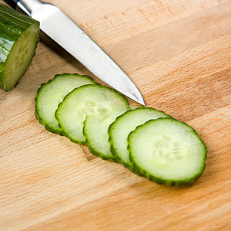

Cucumber

Slide 26

Tomato

Slide 27

Onion

Slide 28
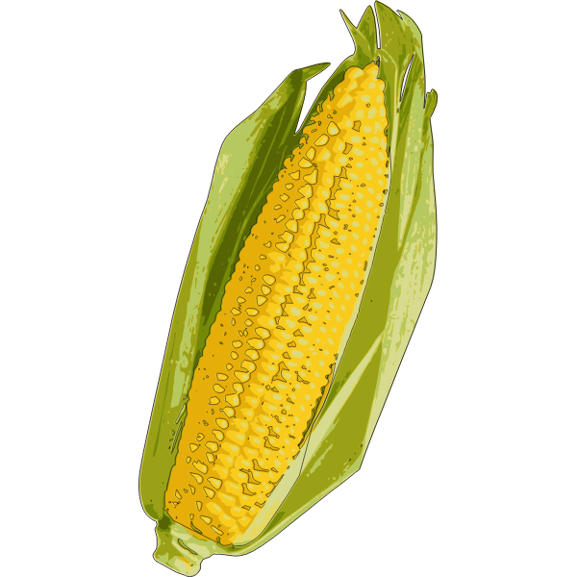
Corn

Slide 29

Cauliflower

Slide 30

Peas

